Slide 1
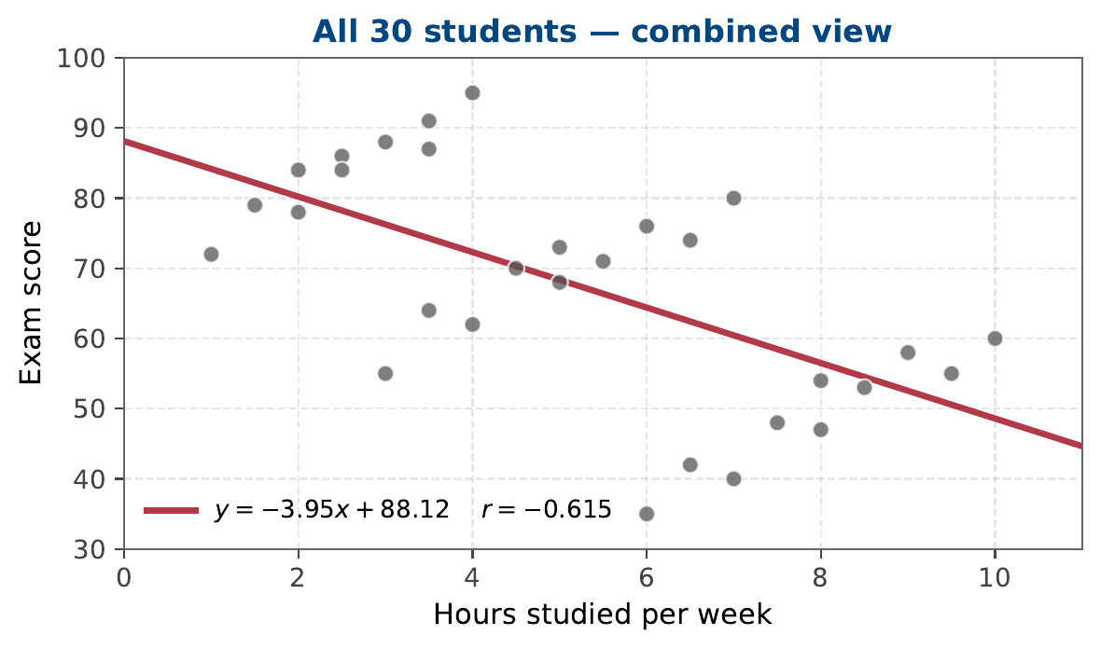
The combined view: one big trend
30 students, study hours vs exam score
Reading the plot:
Trendline slopes downwards. The correlation is
r = −0.615
The conclusion:
"More study hours seem to lead to lower exam scores."
Does that feel right?
jmaths.xyz
Data Detective — MYP Year 10

Slide 2
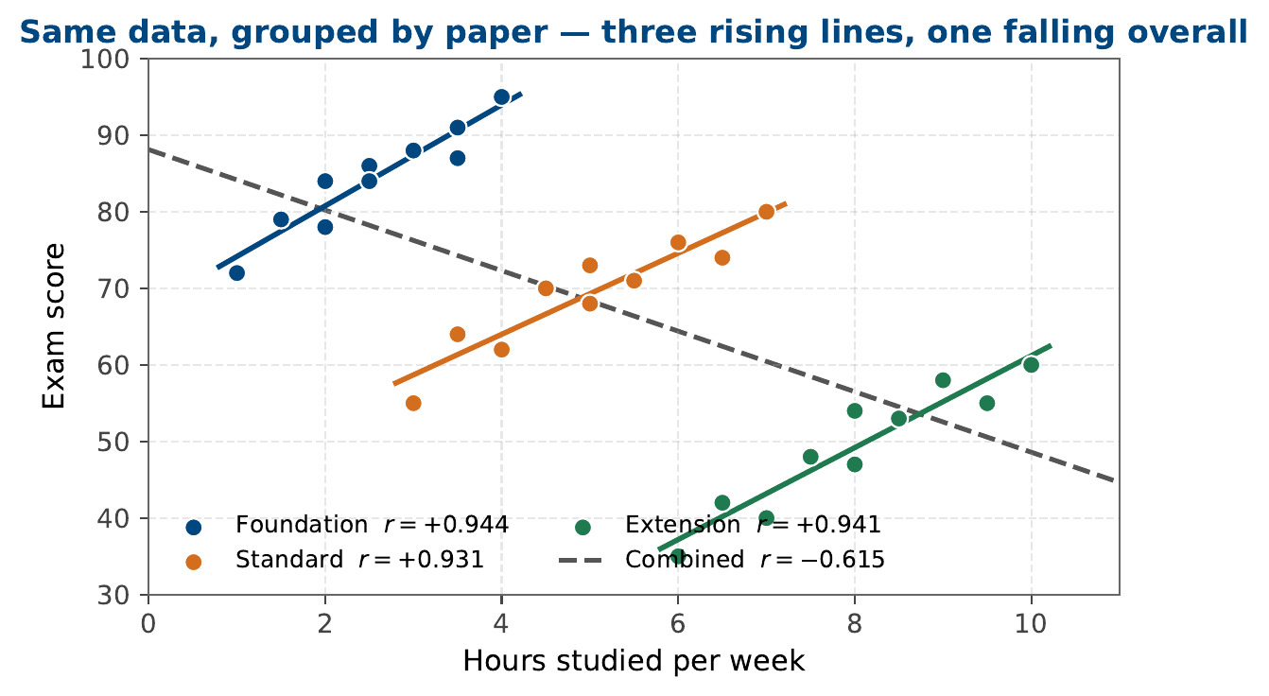
The grouped view: three trends inside one
Same data, split by paper
Within each paper:
Foundation: r = +0.94
Standard: r = +0.93
Extension: r = +0.94
All strongly positive.
Three rising lines.
One falling overall.
The trend reverses — that's Simpson's paradox.
jmaths.xyz
Data Detective — MYP Year 10

Slide 3
The lesson: always look inside the groups
✗ Headline reading
✓ Reading inside the groups
Combined r = −0.615
"Study more, score less."
Treats all 30 students as one group. Hides the fact that they sat three different papers of different difficulty.
Per-paper r ≈ +0.94
"More study → higher score in your paper."
Compares like with like. The paper students sat was the hidden variable distorting the overall figure.
Always ask: what groups are inside the data?
jmaths.xyz
Data Detective — MYP Year 10

